Slide 1

Personal – Folie1
Excite New Applicants
Gaining efficiency and enthusiasm by implementing transparency and AI in your hiring process
Team PEACHES
Nils Beutling, Lukas Oester, Luca Schädler, Jonathan Lerch
MSc Business Information Systems
June 2023

Slide 2

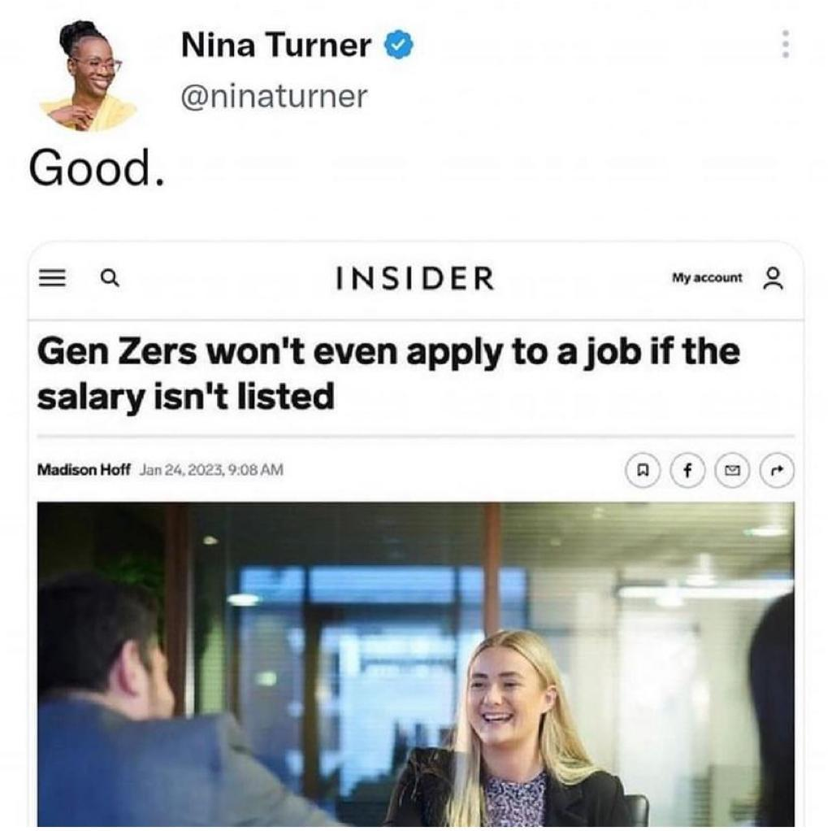
Personal – Folie9
Recruiting Today
Trigger
Notes:
https://www.facebook.com/TheOther98/photos/d41d8cd9/648347194003950/?paipv=0&eav=Afap0S2a3Iki-CuvuqQ9jyM-itWfXjwYZk2c3j2T1RPtB_E0MjUC9i_FiwzIYtzhSXk&_rdr

Slide 3
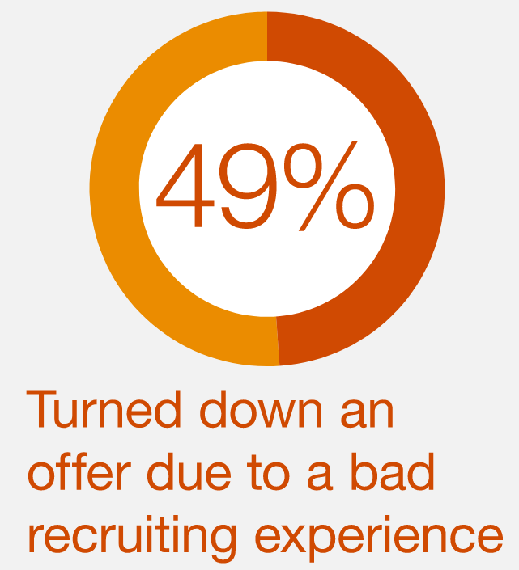

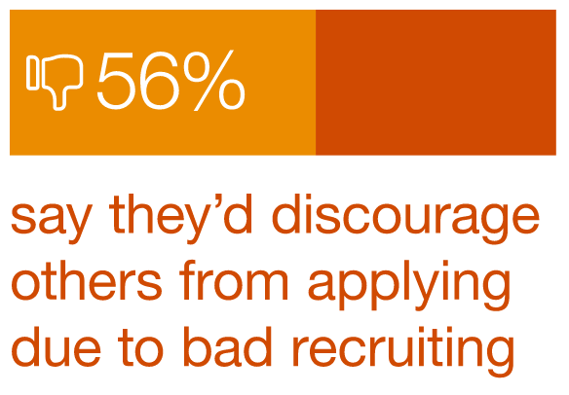
Personal – Folie9
The Future of Recruiting
In Hiring Processes
According to a study by PwC in 2019…
Notes:
Expalining WHY – the problem/ issues in GENERAL (for everyone and each company)
https://www.pwc.com/us/en/services/consulting/business-transformation/library/hr-recruiting.html

Slide 4

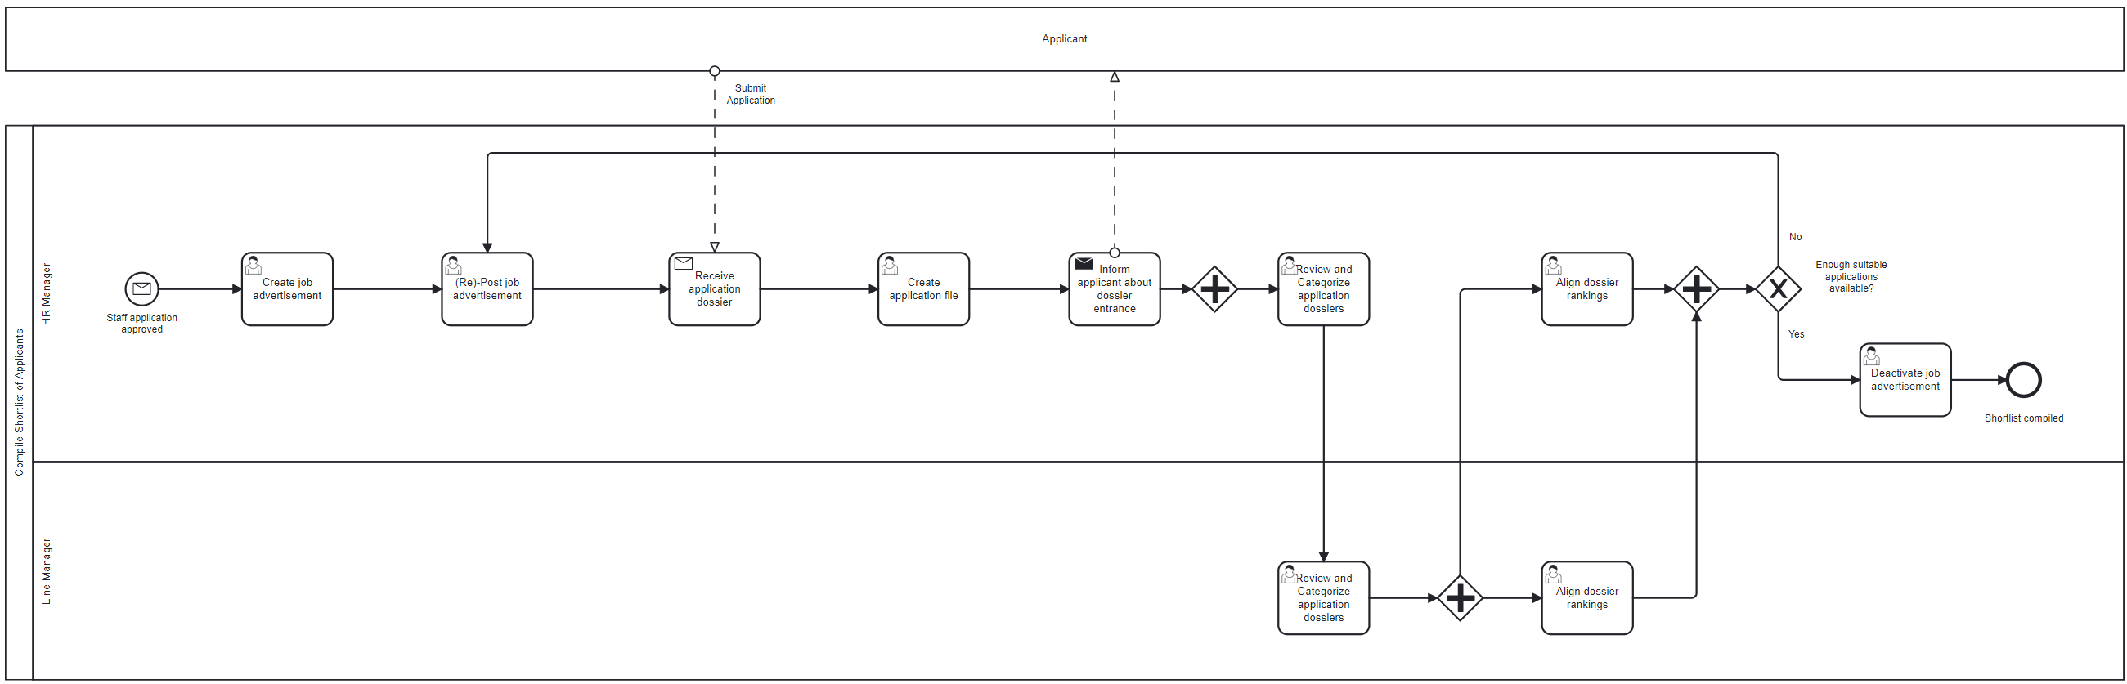
Personal – Folie9
Our Starting Point
AS IS Process
Compile Shortlist of Applicants
Weaknesses
Strategic process with low granularity
No automated tasks
Strong internal focus on the company’s tasks
No traceable or guided workflow
Inefficient and effortful for HR
Applicant’s perspective ignored
Re-post job ad: Do the same expecting different results
Intransparency leads to «false» applications

Slide 5
Personal – Folie9
The Golden Circle
In Hiring Processes
Why
How
What
Employer branding
Wider talent pool
Enhanced candidate experience
Cost-effectiveness and efficiency on both sides
Data insights
New paths – be creative!
From process to experience
Efficiency and transparency
Use state-of-the-art technology
Check applicant-position-fit
Applicant tracking system
Data Analytics
Automated workflow and communication
Check hard factors
Instant individual salary estimation
AI screens CV and visualises applicant’s motivation
File management and central database
WHY

Slide 6

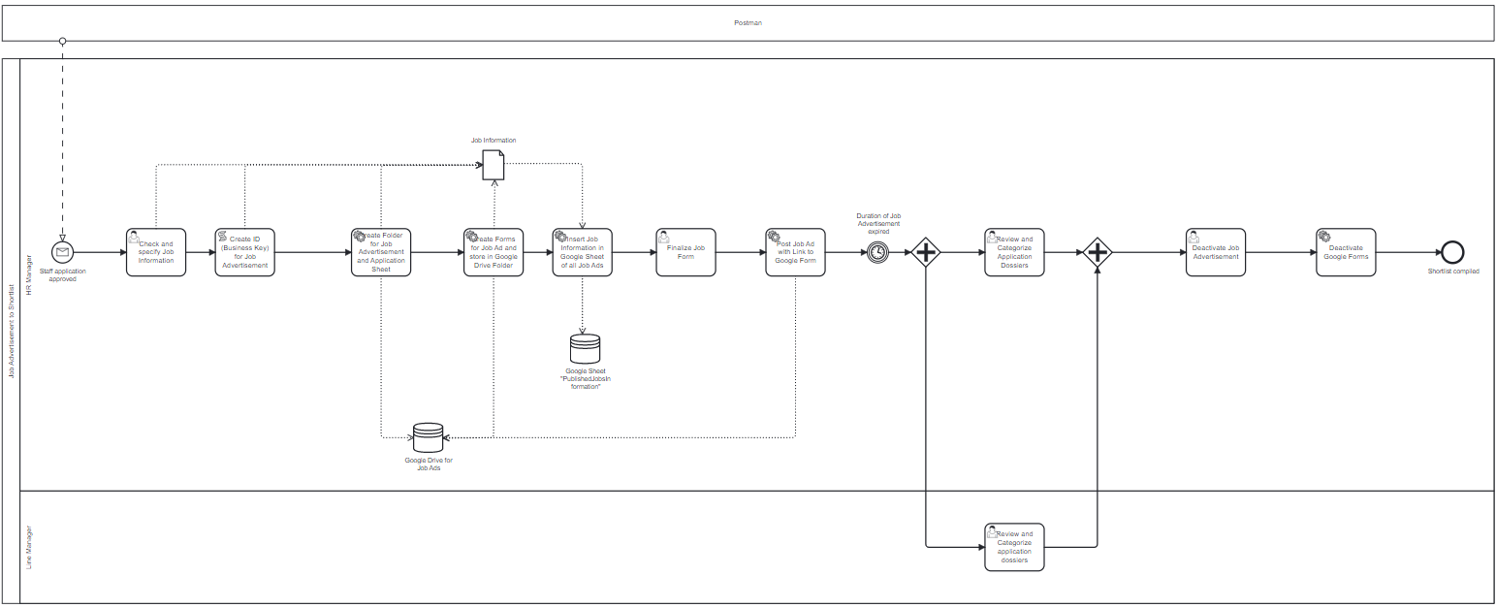
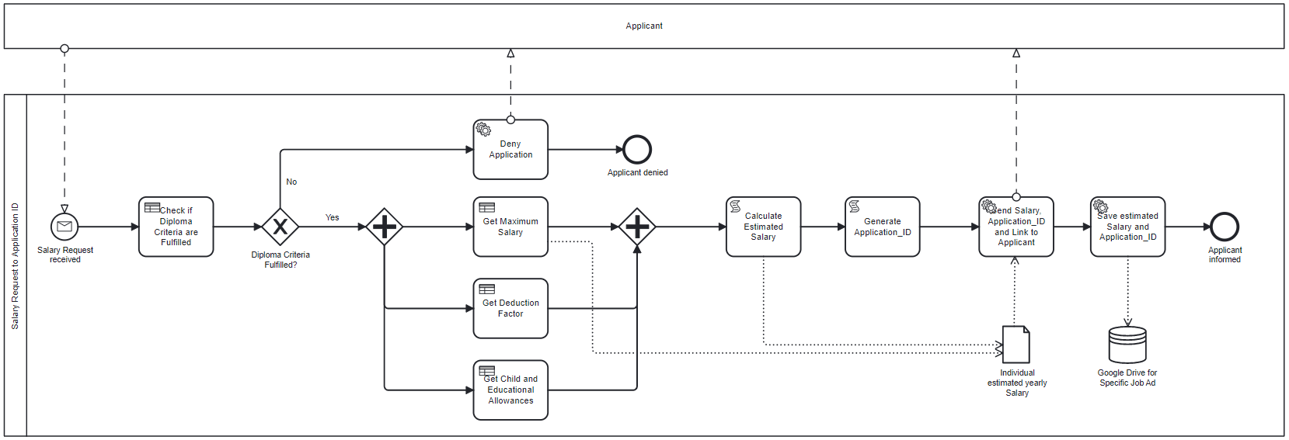
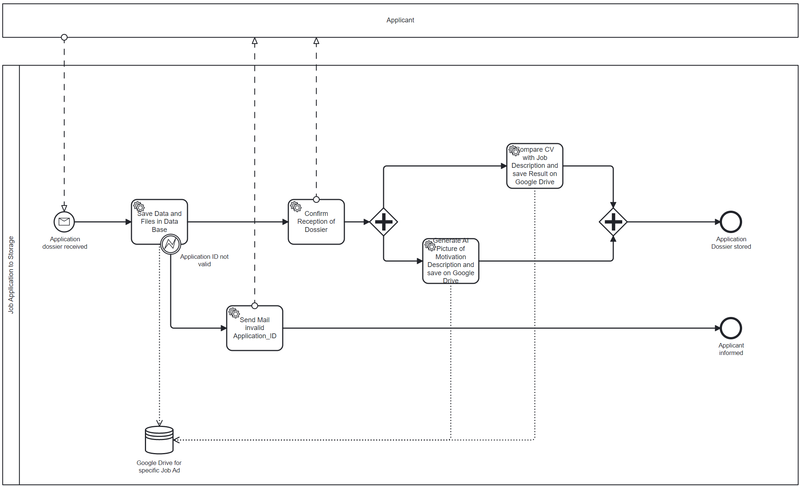
Personal – Folie9
Our Solution
Compile Shortlist of Applicants
Strengths and Improvements
Workflow
Highly automated with services
Considers company’s and applicant’s view with 3 processes
Efficient process with instant responses
Individual salary estimation and diploma check
Unsuitable applicants automatically screened out
Low error probability
Integration of AI services
Improve job ad instead of re-posting it
Applicant tracking system allows data analyses to improve processes, job advertisements, etc.
Notes:
Not end point, it is the current state

Slide 7
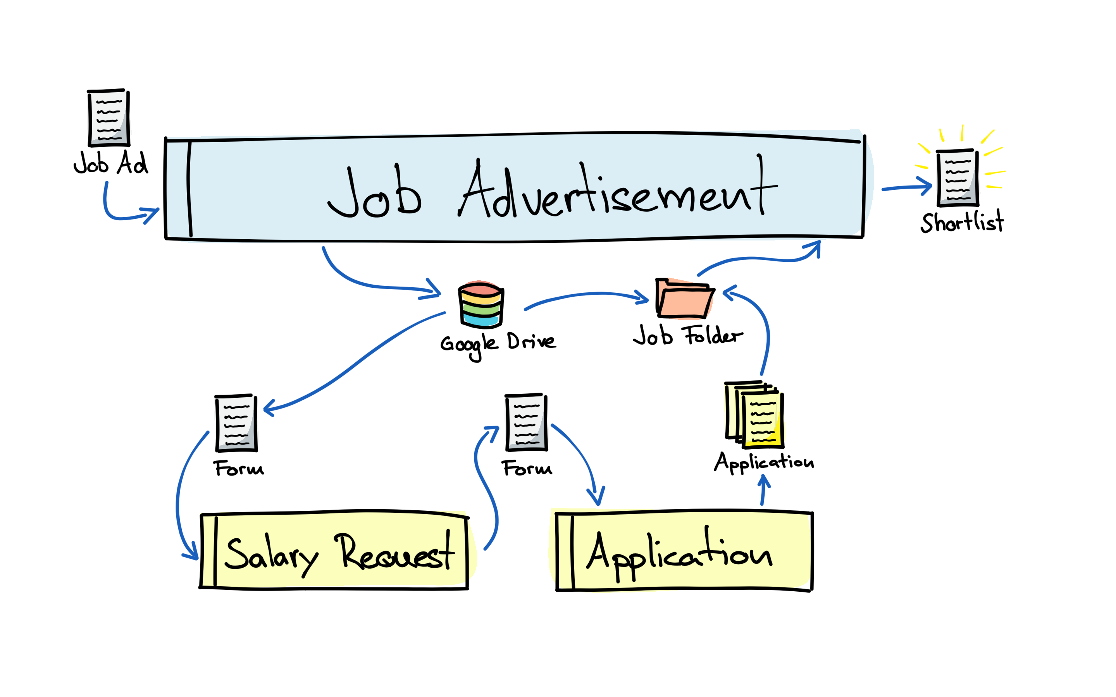


Personal – Folie9
Our Solution
Notes:
Not end point, it is the current state

Slide 8

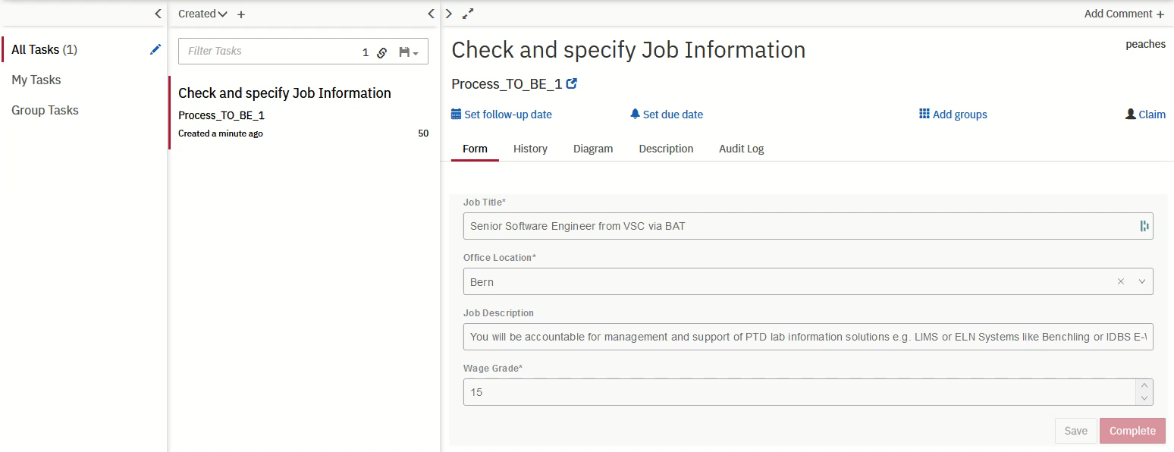
Personal – Folie4
Customer Success Story - HR
Notes:
HOW
Highlight some extraordinary points

Slide 9
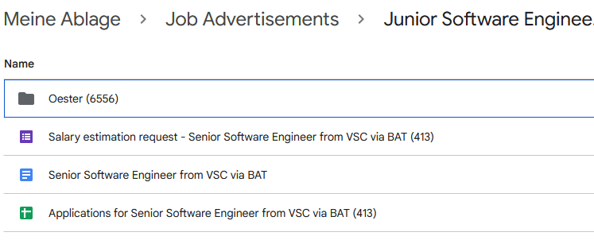
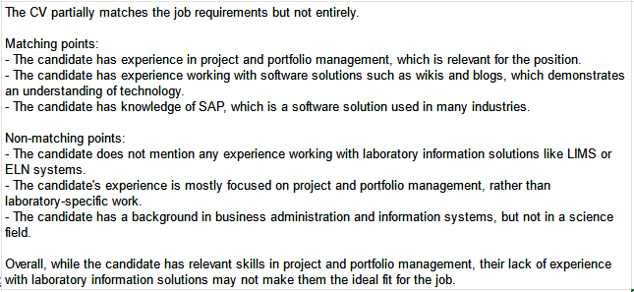
Personal – Folie4
Customer Success Story - HR
Automation
Use of AI to enrich data
Notes:
Automation:
Creats all needed documents and organizes them
Fast, easy, reliable and high quality
I keep controll over key Steps
AI
Quick option to check for intresting candidats before I check CV

Slide 10

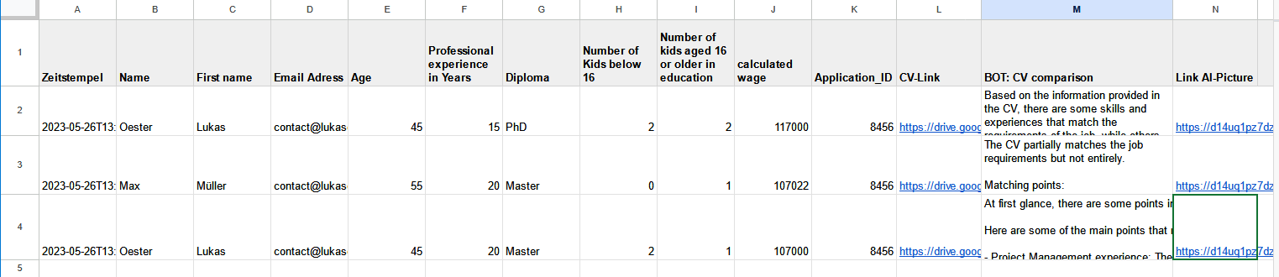
Personal – Folie4
Customer Success Story - HR
AI Picture – Talking Point
Shortlist
Notes:
AI Picture:
Great starting point for Interview, does he see his personality reflected?
Shortlist
- Great compiled sheet with all important data in one place

Slide 11
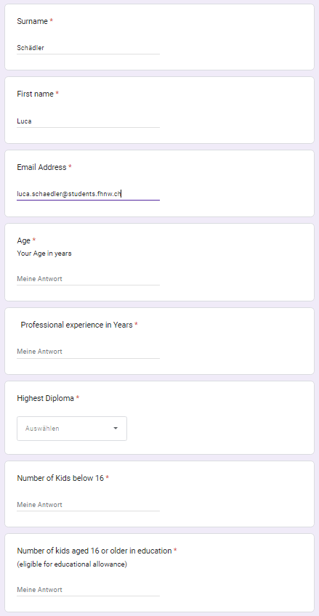
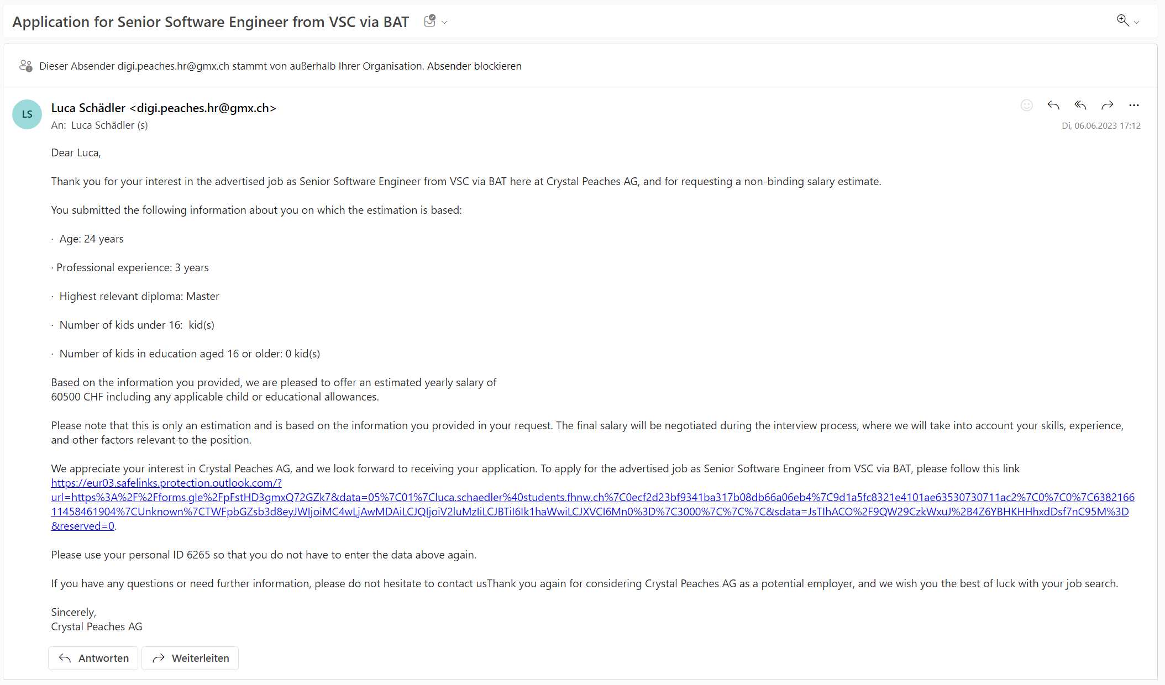
Personal – Folie4
Customer Success Story - Applicant
Salary estimation request
E-Mail
Notes:
The new and digitalised process not only has advantages for HR, but also brings various benefits for the applicant.
The first big advantage and at the same time an innovation in the process is that the applicant can have his/her personal salary calculated. All they have to do is click on the link of the job advertisement and enter their data. The applicant then receives a personal salary for this job directly by e-mail. The applicant can then decide whether or not to apply for the job. If he wants to apply, the link for submitting the documents is also included in the mail with the estimated salary.

Slide 12
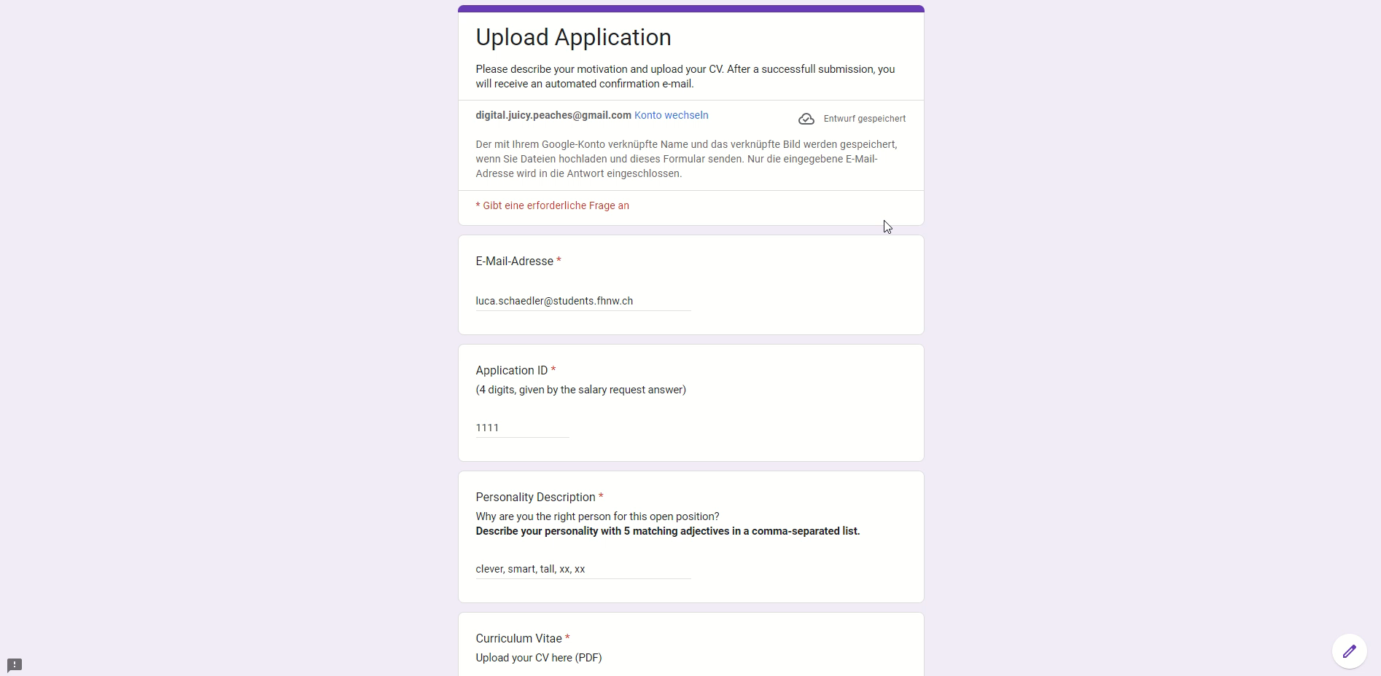
Personal – Folie4
Customer Success Story - Applicant
Notes:
In order to uniquely identify the applicant again when applying, so that he/she does not have to enter his/her data again when applying, a unique ID is generated, which the applicant must enter when uploading his/her application documents.
The process ensures that if the applicant enters an incorrect ID, the system notifies the applicant by email. This exception handling ensures that the applicant is uniquely identified.

Slide 13

Personal – Folie9
Your Reactions & Questions
Let‘s go into an interactive discussion
What would be your reaction as an applicant to the new process and features like…
Salary check?
AI picture of motivation description?
Notes:
CALL to ACTION! Are you ready to innovate your hiring process? Otherwise you don‘t catch suitable appliacants in todays world (Shortage of skilled workers)

Slide 14
Bibliography and Figures
https://www.facebook.com/TheOther98/photos/d41d8cd9/648347194003950/?paipv=0&eav=Afap0S2a3Iki-CuvuqQ9jyM-itWfXjwYZk2c3j2T1RPtB_E0MjUC9i_FiwzIYtzhSXk&_rdr
https://www.pwc.com/us/en/services/consulting/business-transformation/library/hr-recruiting.html
https://www.flaticon.com/free-icon/office-building_4300059?term=company&page=1&position=2&origin=search&related_id=4300059
https://www.flaticon.com/free-icon/recruiting_10488693?term=man+women&page=1&position=20&origin=search&related_id=10488693
https://www.flaticon.com/free-icon/human-resources_4126442?term=hr&page=1&position=5&origin=search&related_id=4126442

Slide 15




Notes:
HR: https://www.flaticon.com/free-icon/human-resources_4126442?term=hr&page=1&position=5&origin=search&related_id=4126442
Now hiring: https://www.flaticon.com/free-icon/hiring_10485108?related_id=10485108
Selection 1 of 3: https://www.flaticon.com/free-icon/recruitment_10485035?related_id=10485035
Satisfaction: https://www.flaticon.com/free-icon/best-customer-experience_10936461?related_id=10936461
Check CV: https://www.flaticon.com/free-icon/profile_10485080?related_id=10485080
Man and woman: https://www.flaticon.com/free-icon/recruiting_10488693?term=man+women&page=1&position=20&origin=search&related_id=10488693

Slide 16






Notes:
Process: https://www.flaticon.com/free-icon/planning_762620?term=process&page=1&position=10&origin=search&related_id=762620
Form: https://www.flaticon.com/free-icon/google-forms_2913988?term=form&page=1&position=17&origin=search&related_id=2913988
Sheet: https://www.flaticon.com/free-icon/google-sheets_2913989?term=sheet&page=1&position=12&origin=search&related_id=2913989
Mail: https://www.flaticon.com/free-icon/email_539232?term=mail&page=1&position=32&origin=search&related_id=539232
Software: https://www.flaticon.com/free-icon/application_5044729?term=application&page=1&position=3&origin=search&related_id=5044729
Folder: https://www.flaticon.com/free-icon/folder_1379905?term=folder&page=1&position=5&origin=search&related_id=1379905

